Slide 1
Data Analysis
Pandas Operations

Slide 2
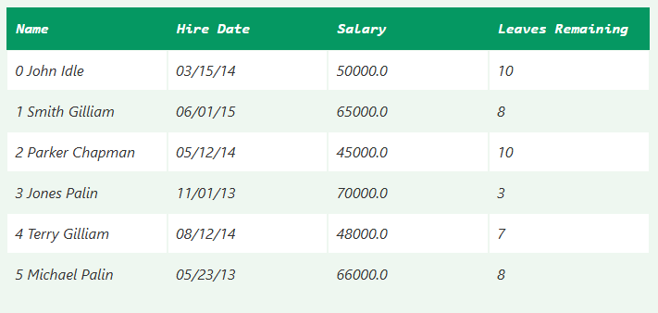
Sample.csv

Slide 3
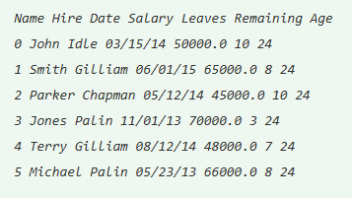
Add new column using [] operator
import pandas as pd
aa = pd.read_csv("aa.csv")
aa["Age"] = "24"
aa.head()

Slide 4
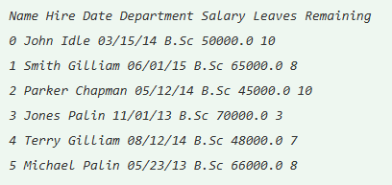
Add new columns in a DF using insert()
import pandas as pd
aa = pd.read_csv("aa.csv")
aa.insert(2, column = "Department", value = "B.Sc")
aa.head()

Slide 5
Data Frame to Numpy Array
#Syntax
DataFrame.to_numpy(dtype=None, copy=False)
dtype: It is an optional parameter that pass the dtype to numpy.asarray().
copy: It returns the boolean value that has the default value False.
It returns the numpy.ndarray as an output.
Notes:
https://www.tpointtech.com/convert-pandas-dataframe-to-numpy-array

Slide 6

Example 1
import pandas as pd
pd.DataFrame({"P": [2, 3], "Q": [4, 5]}).to_numpy()
info = pd.DataFrame({"P": [2, 3], "Q": [4.0, 5.8]})
info.to_numpy()
info['R'] = pd.date_range('2000', periods=2)
info.to_numpy()
Notes:
https://www.tpointtech.com/convert-pandas-dataframe-to-numpy-array

